Slide 1
(Q)LDPC Codes
By: Jack, Chris, Robert

Slide 2
Project Plan
Introduction to LDPC / LDPC Linear Algebra
Introduction to Quantum LDPC
Simulation of Quantum LDPC Code
Empirical Validation and Analysis
Notes:
Simulation of Quantum LDPC Codes:
Apply the principles learned and tools developed in the previous steps to simulate quantum LDPC codes. This involves constructing a quantum circuit that replicates the operation of LDPC codes on a quantum computer. Focus will be on the translation of classical LDPC codes into the quantum domain, utilizing sparse matrix techniques and quantum error correction methods to demonstrate fault tolerance and error correction efficacy.
Empirical Validation and Analysis:
Use IBM's quantum computing resources, specifically Qiskit and IBM Quantum Composer, to validate the theoretical models and simulations. Perform experiments to encode and decode information using quantum LDPC codes, analyzing the results for accuracy, efficiency, and error rates. Conclude with a comprehensive evaluation of the scalability and practical implications of quantum LDPC codes in real-world quantum computing applications.

Slide 3
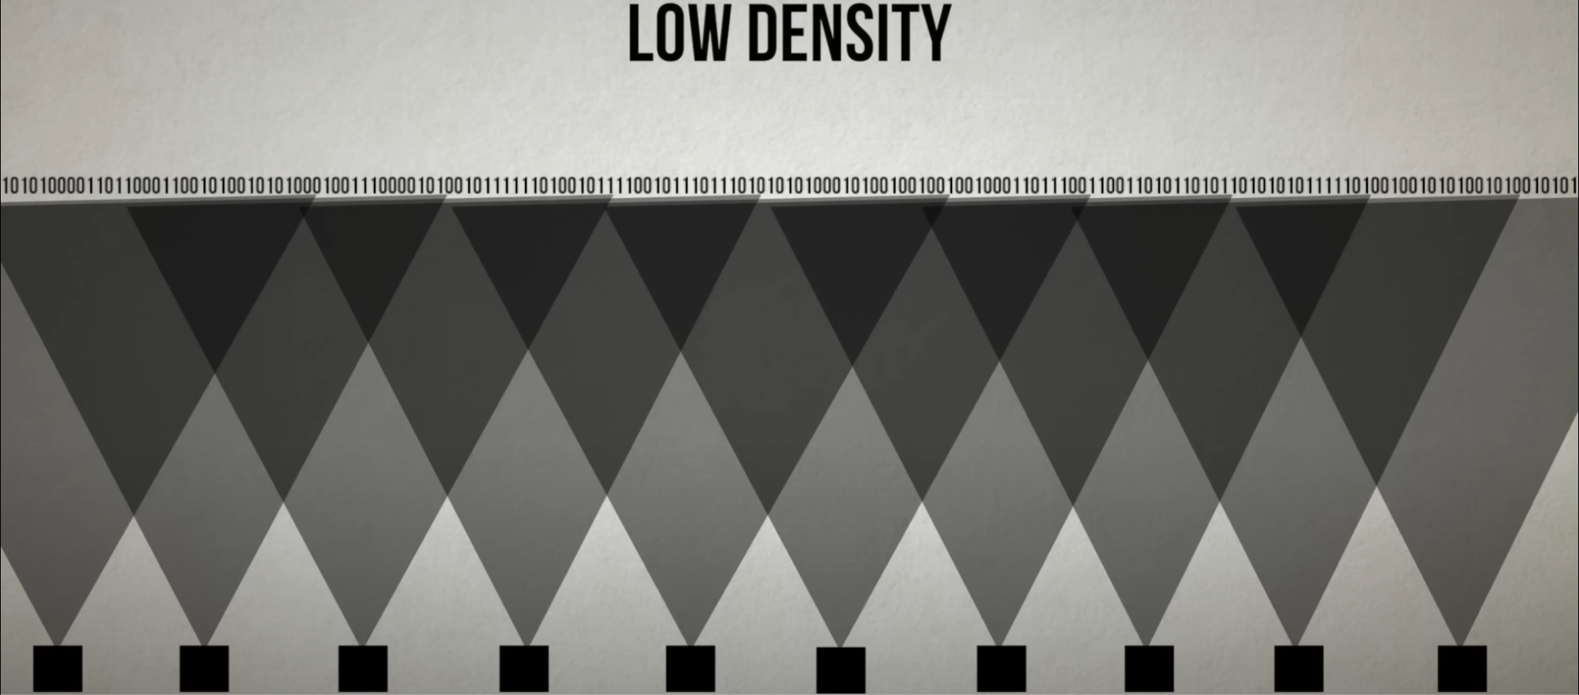
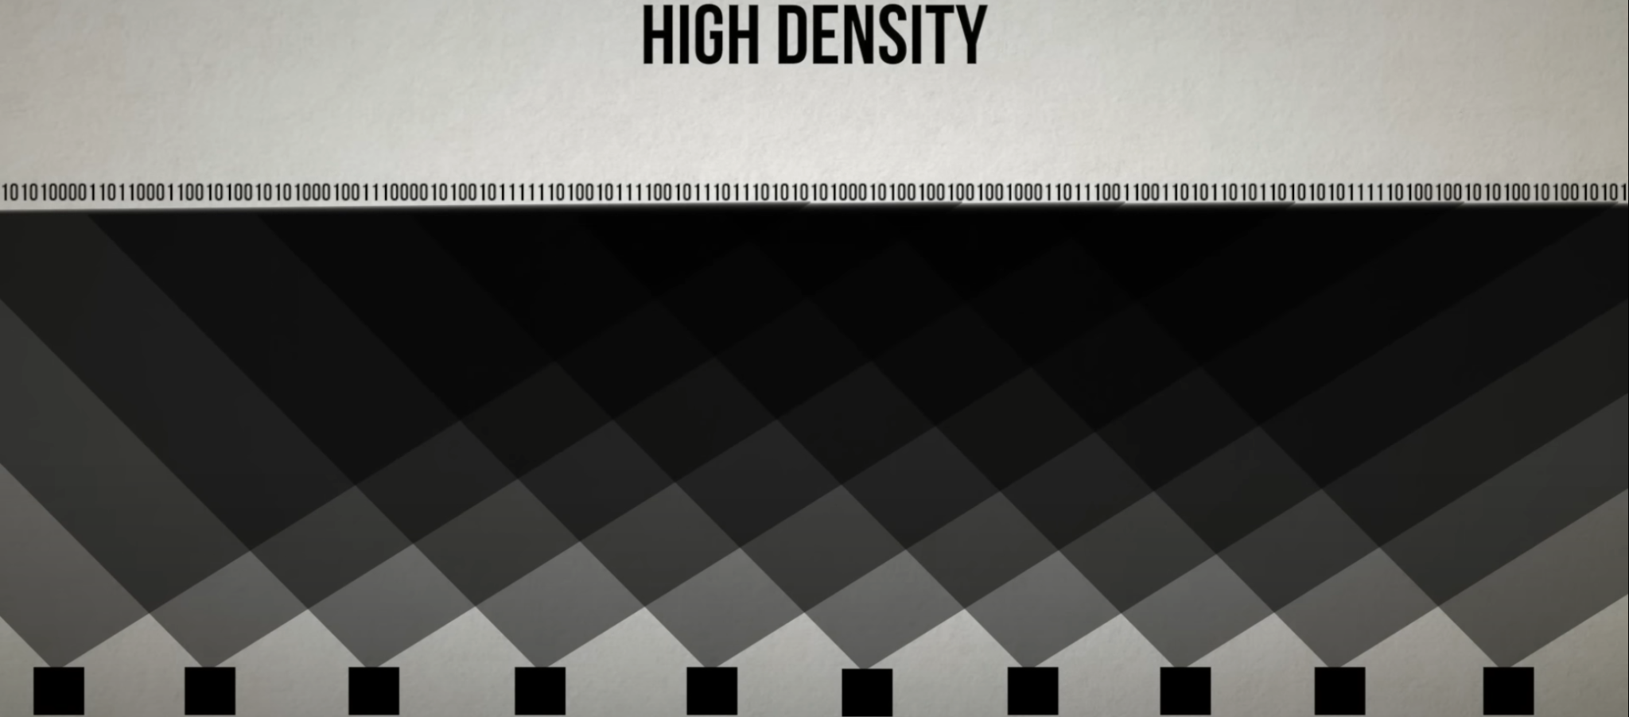
What is LDPC?
LD - Low Density
Density: The overlap of bits between Parity Check Sets - the amount of sets the same bit is in.
PC - Parity Check
Parity Check (bits): The bits used to check the ‘parity’-the amount of 1’s- in a string of bits.
Benefits
High rates of erasure can be tolerated, the code rate is not sacrificed, encoding and decoding are simpler.
Notes:
LDPC IS a type of error correction code. It using parity check sets, which all have low density, to protect a string of bits against errasures.

Slide 4
Math behind it
LDPC Codes: Low amount of 1’s compared to total amount of elements in matrix
n x m: rows by columns
W_{c}: Amount of 1’s in each column
W_{r}: Amount of 1’s in each row
Regular: uniform amount of 1’s in each row AND column. (referred to as degrees)
Fulfills the equation W_{r} = W_{c} * (m/n)
Irregular: non uniform amount of 1’s for each row or column.

Slide 5

Parity Equations
Each row of an LDPC matrix represents a parity equation
Any variable with a 1 in that row is a part of the parity check equation
Parity check equations can be thought of as XOR between the variables
If the right-most bit is x₀, then we have x₅+ x₂+ x₀ = 0
x₅ ⊗ x₂ ⊗ x₀ = 0

Slide 6
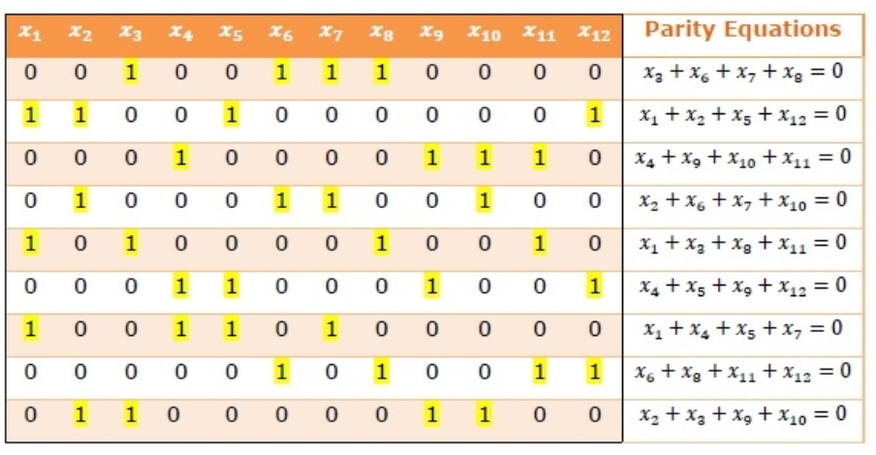
Example of LDPC Matrix
Regular (12,3,4) Low Density Parity Check Matrix

Slide 7
Algorithms for Generating LDPC Matrices
Random Generation - creates a random sparse graph and modify it. (surprisingly effective)
If regular, modify each row and column to have fixed degrees.
If irregular, modify matrix to be low density (below a certain percentage of 1’s).
Gallagher's Algorithm - creates a regular LDPC matrix by partitioning a n x m matrix into different blocks of (m / W_c) x n size. For the 1st block, place 1’s in the first m / W_c rows and every corresponding column. For every subsequent block, offset where you place the 1’s. Combine the blocks together to form the LDPC matrix.
These two are some of the more simple implementations that use a pseudorandom approach, but other methods such as finite geometries also use combinatorial approaches.

Slide 8
What is QLDPC
Construction:
Parity-Check Matrix
Stabilizer Formalism
Tanner Graph
Encoding:
Logical Qubits
Syndrome Measurement:
Measure Parity Checks
Decoding:
Syndrome Decoding
Belief Propagation
Correction:
Apply Corrections
Notes:
Parity-Check Matrix: Construct a sparse parity-check matrix that defines the code. This matrix has a low density of non-zero elements, which helps in efficient decoding.
Stabilizer Formalism: Use the stabilizer formalism to define the code. Quantum stabilizer codes are a generalization of classical linear codes to the quantum domain.
Tanner Graph: Represent the parity-check matrix using a Tanner graph, where nodes represent qubits and check nodes represent parity-check constraints.
Measure Parity Checks: Measure the stabilizers or parity checks to detect errors. This involves measuring ancillary qubits coupled to the data qubits to extract error syndromes.
Syndrome Decoding: Use the measured syndrome information to identify the most likely error pattern. Decoding algorithms, often iterative, are used to process the sparse parity-check matrix and the syndrome.
Belief Propagation: A common decoding algorithm for QLDPC codes is belief propagation, adapted from classical LDPC decoding, which iteratively updates beliefs about the presence of errors based on syndrome information.
Apply Corrections: Once the error pattern is identified, apply the appropriate quantum gates to correct the errors and restore the quantum state to its intended form.

Slide 9
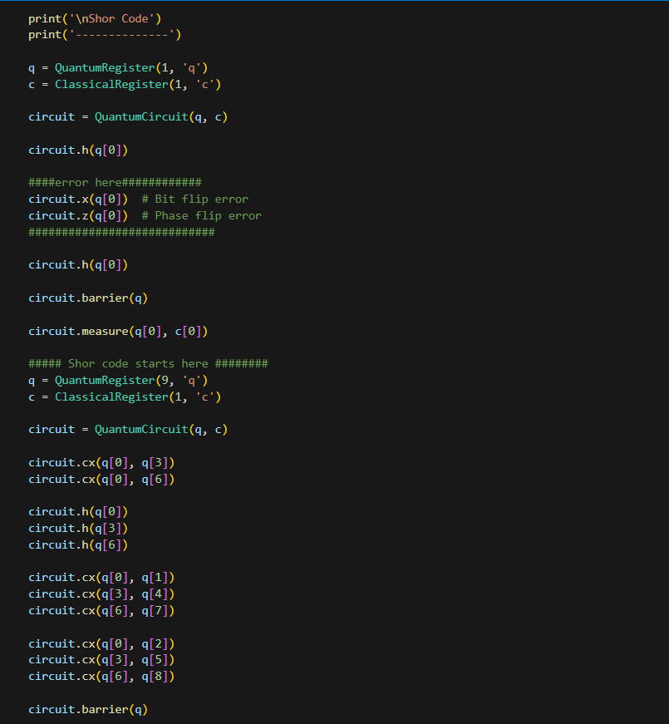
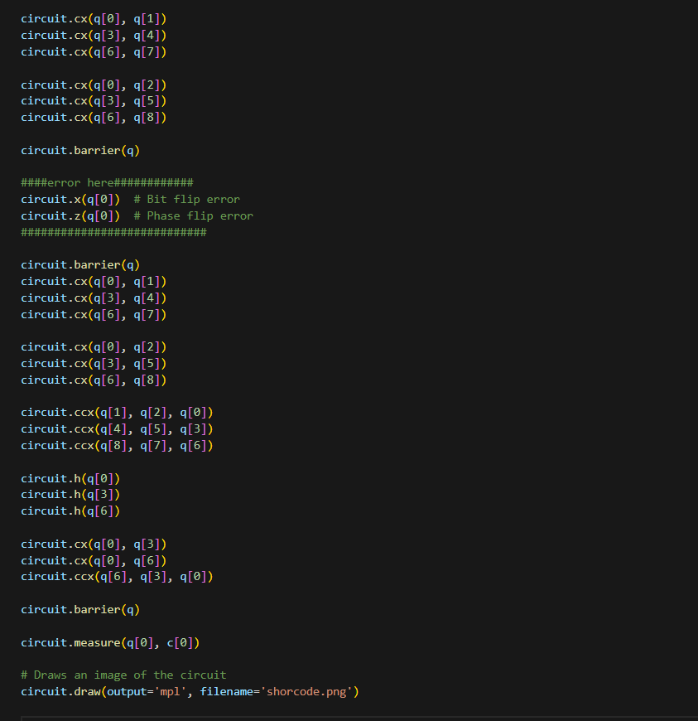
Our progress for quantum implementation
Notes:
Shor's code, named after mathematician Peter Shor, is a quantum error-correcting code that encodes 1 logical qubit into 9 physical qubits. It is capable of correcting both bit-flip and phase-flip errors, and it was one of the first quantum error-correcting codes to be discovered.
quantum low-density parity-check (qLDPC) codes are a class of quantum codes that can be used with Shor's algorithm. Shor's algorithm uses quantum error correcting codes to protect quantum information by introducing redundancy. LDPC codes are a type of classical code that are efficient at correcting errors in information storage and transfer, and they offer a high level of protection with a relatively small amount of redundancy

Slide 10
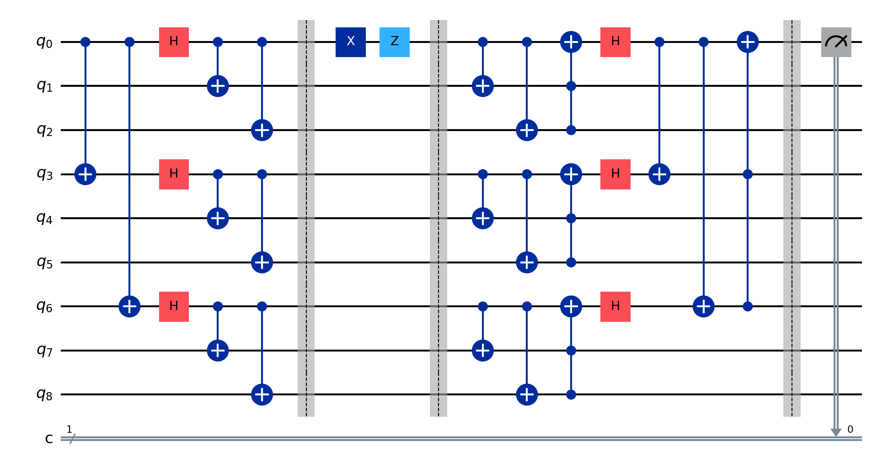
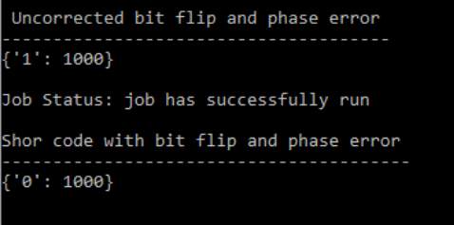
Results

Slide 11
Reference
Roffe, J. (2021, November 30). Towards practical quantum LDPC codes. Quantum. https://quantum-journal.org/views/qv-2021-11-30-63/
Hidary, J. (2019). Quantum Computing: An applied approach. Springer.
Part 1-4 Quantum LDPC codes | Nicolas Delfosse (Microsoft Research) https://www.youtube.com/watch?v=_SS1gS31Wdk&t=229s
Roffe, J. (2021, November 30). Towards practical quantum LDPC codes. Quantum. https://quantum-journal.org/views/qv-2021-11-30-63/

